Slide 1
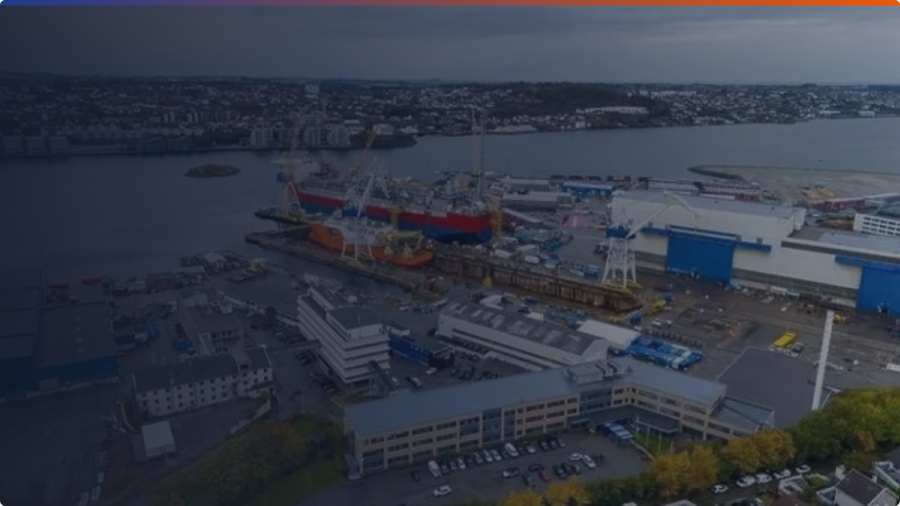
ABC Shipyard:
Facility Layout & Process
Improvement Case
Submitted by:
ROHIT GHOSH MBA25084
ANISH DEY MBA25058
NAMAN SRIVASTAV MBATM25014
SHREYA YADAV MBA25090
ABHISHEK JOSHI MBA25051
YOGANSHI MBA25096
SHASHANK KURNAL MBA25226

Slide 2


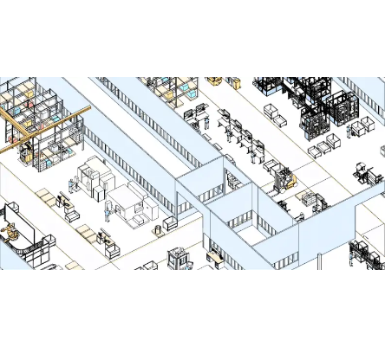

What is Facility Layout?
Definition
Facility layout refers to the arrangement of physical facilities and resources such as machines, shops, equipment, and storage areas within a manufacturing system.
Goal: Ensure efficient material flow, minimal handling cost, high throughput, and production flexibility.

Slide 3


Layout Types & Selection Factors
Types of Layout
Determining Factors
•
Process-oriented: Functional layout (grouping similar machines).
•
Volume and variety of production.
•
Flow and movement of materials.
•
Product-oriented: Line or continuous flow.
Space and handling constraints.
•
•
Fixed-position: Product stays, resources come to it.
Cost and investments required.
•
Cellular / Hybrid: Combination for flexibility.
•
Technology and labor intensity.
•

Slide 4
Layout Types Identified in ABC Shipyard
Shop / Area | Type of Layout
Steel Shop, Pipe Shop, Paint Shop | Process-focused Layout (Functional grouping)
Block Erection Area, Docks, Quay | Fixed-position Layout (Large scale assembly)
Proposed Flat & Curved Plate Cells | Product-oriented / Cellular (Streamlined flow)

Slide 5


Impact of Product-Oriented Layout & TOC
Impact on WIP
Impact on Throughput
•
Better synchronization reduces WIP accumulation.
•
Maximizes utilization of the constrained resource (Block Erection Area).
•
Prevents blocking and waiting due to missing plate types.
•
Ensures faster block completion and linear material flow.
•
Resolves semi-finished blocks congestion on the floor.
•
Reduces overall cycle time & increases ship delivery rate.
TOC Principle:

Slide 6
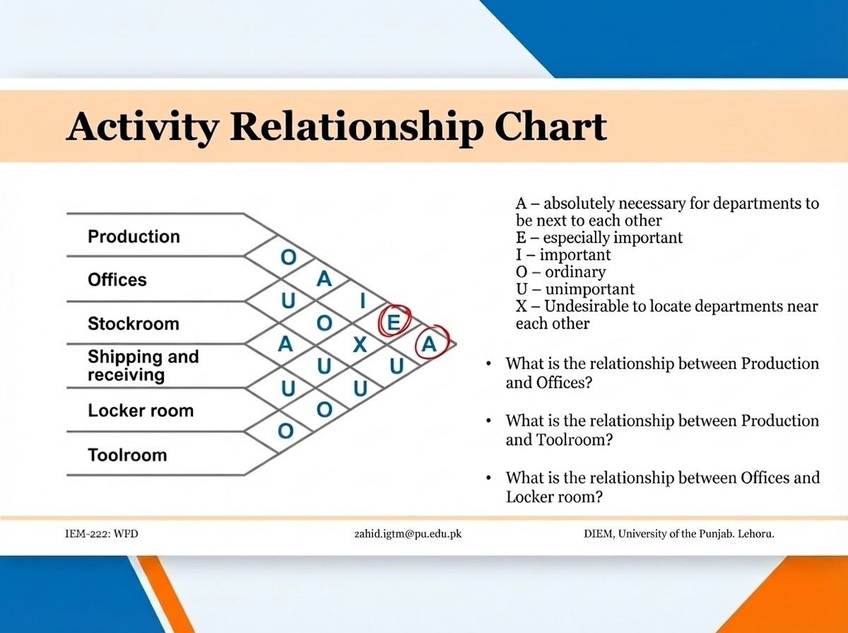
What is an REL Chart?
Definition
A Relationship (REL) chart is a systematic layout planning tool used to evaluate and document the necessary closeness relationships between departments based on process flow and dependency.
Key Factors Considered
•
Frequency of material movement
•
Handling cost reduction
•
Workflow sequence requirements
•
Safety, supervision & communication
•
Utility and crane access constraints

Slide 7






Analysis & Process Improvements
Steel ↔ Paint
Warehouse Location
Improvement Outcome
These shops should be closer. There is a major material flow from cutting (Steel) to priming (Paint) that is currently inefficient.
Currently near the office (unnecessary). It should be moved closer to General Purpose & Outfitting shops to reduce transport.
Reduce handling delays and transportation time.
Result: Improved cycle time and overall throughput.

Slide 8


Limitations in Restructuring
Practical Limitations
Monetary Limitations
Availability of skilled labor and training requirements.
Lack of physical space during the rearrangement phase.
Limited shutdown windows due to active ship orders.
Disruption to current production if heavy machinery is relocated.
•
High cost of relocating heavy equipment, cranes, and buildings.
•
Significant upfront investment in redesign and infrastructure.
•
Opportunity cost of lost production time during the transition.

Slide 9


Conclusion
Challenge: ABC Shipyard suffers from excess WIP and bottlenecks at block erection.
Solution: Implementing TOC and a product-oriented layout can effectively resolve bottlenecks.
Tool: REL-based layout redesign will significantly improve material flow and throughput.
Verdict:

